Slide 2
Introduction to
Part 1
Notes:
- Welcome and thank you for coming
- Introduction
- aims:
-- introduce fundamentals
-- build up confidence for self-study!!! Not as scary as the real-world version
- assumptions:
-- basic high-school maths
-- no prior experience in coding
CC-BY Digital Skills Team at the University of Edinburgh www.ed.ac.uk/is/skills

Slide 3
Python 编写IDE
什么是IDE (Integrated Development Environment)？集成开发环境的缩写
为什么需要IDE？IDE是一种辅助程序开发人员开发软件的应用软件，在开发工具内部就可以辅助编写源代码文本、并编译打包成为可用的程序，有些甚至可以设计图形接口。

Slide 4
Python 编写IDE
IDE通常包括编程语言编辑器、自动构建工具、通常还包括调试器。有些IDE包含编译器／解释器，如微软的Microsoft Visual Studio，有些则不包含，如Eclipse、SharpDevelop等，这些IDE是通过调用第三方编译器来实现代码的编译工作的。有时IDE还会包含版本控制系统和一些可以设计图形用户界面的工具。许多支持面向对象的现代化IDE还包括了类别浏览器、对象查看器、对象结构图。虽然目前有一些IDE支持多种编程语言（例如Eclipse、NetBeans、Microsoft Visual Studio），但是一般而言，IDE主要还是针对特定的编程语言而量身打造（例如Visual Basic、Spyder）。

Slide 5
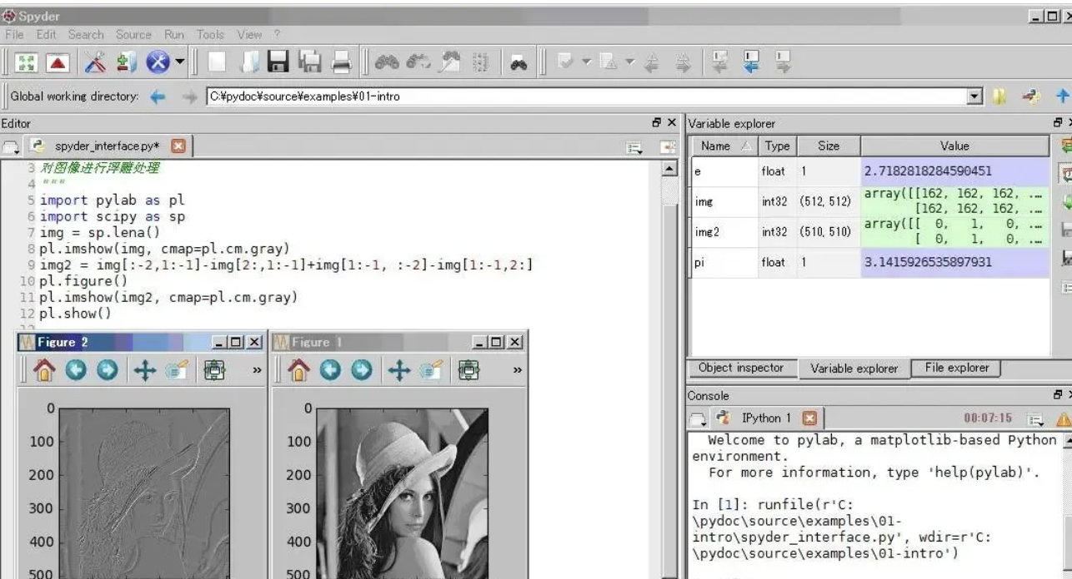
主流的IDE--Spyder
Spyder是Python(x,y)的作者为它开发的一个简单的集成开发环境。和其他的Python开发环境相比，它最大的优点就是模仿MATLAB的"工作空间"的功能，可以很方便地观察和修改数组的值。最出名的python数据科学发行版本Anaconda自带了Spyder。

Slide 6
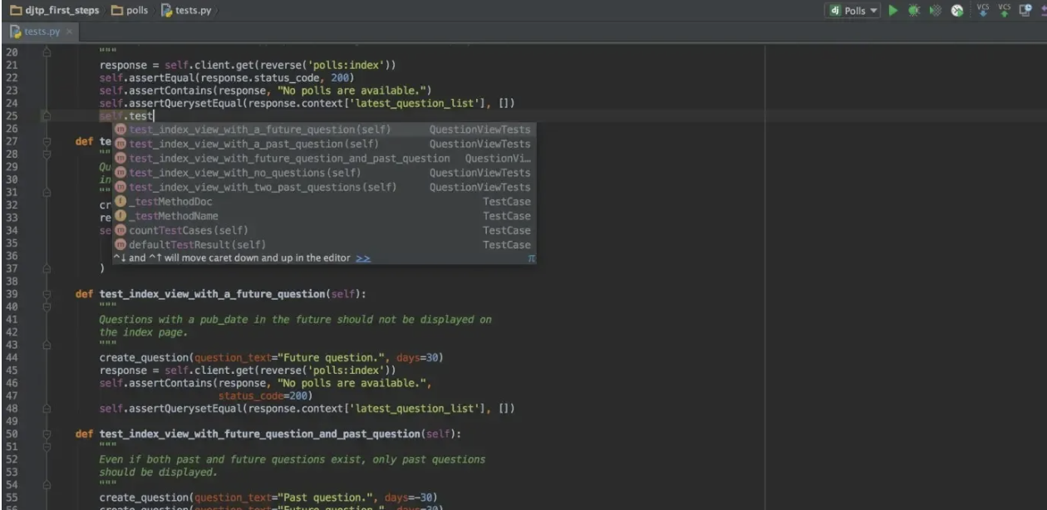
主流的IDE--PyCharm
Pycharm IDE可实现智能代码完成，动态错误检查和快速修复，简单的项目导航等等。 它提供了高效Python开发所需的所有工具。
数以千计的插件和集成终端以进行版本控制。
在您编码时向您显示PEP-8建议
它支持大量的Python库。
与virtualenv，Docker和Vagrant轻松集成。 它还与Git集成。
惊人的重构支持。

Slide 7
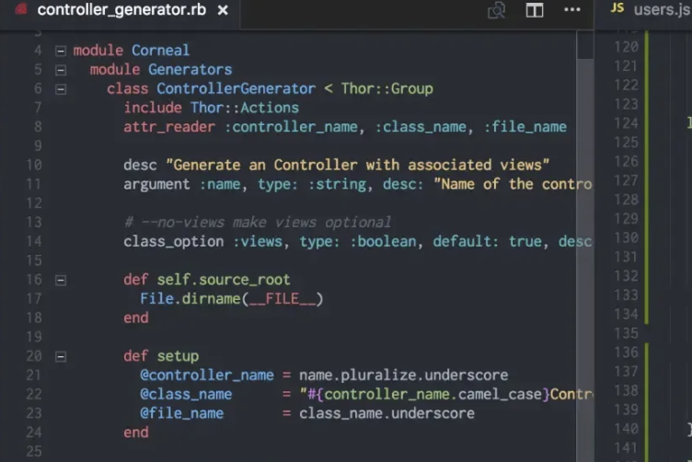
主流的IDE--Visual Studio Code
Microsoft的代码编辑器，易用性好。有语法和错误突出显示以及自动构建等功能。visual studio代码支持使用IntelliSense进行语法突出显示和自动完成。提供基于变量类型，函数定义和导入模块的智能完成。您可以轻松安装扩展以添加新语言，主题，调试程序以及连接到其他服务。扩展程序在不同的进程中运行，确保它们不会减慢编辑器的速度。

Slide 8
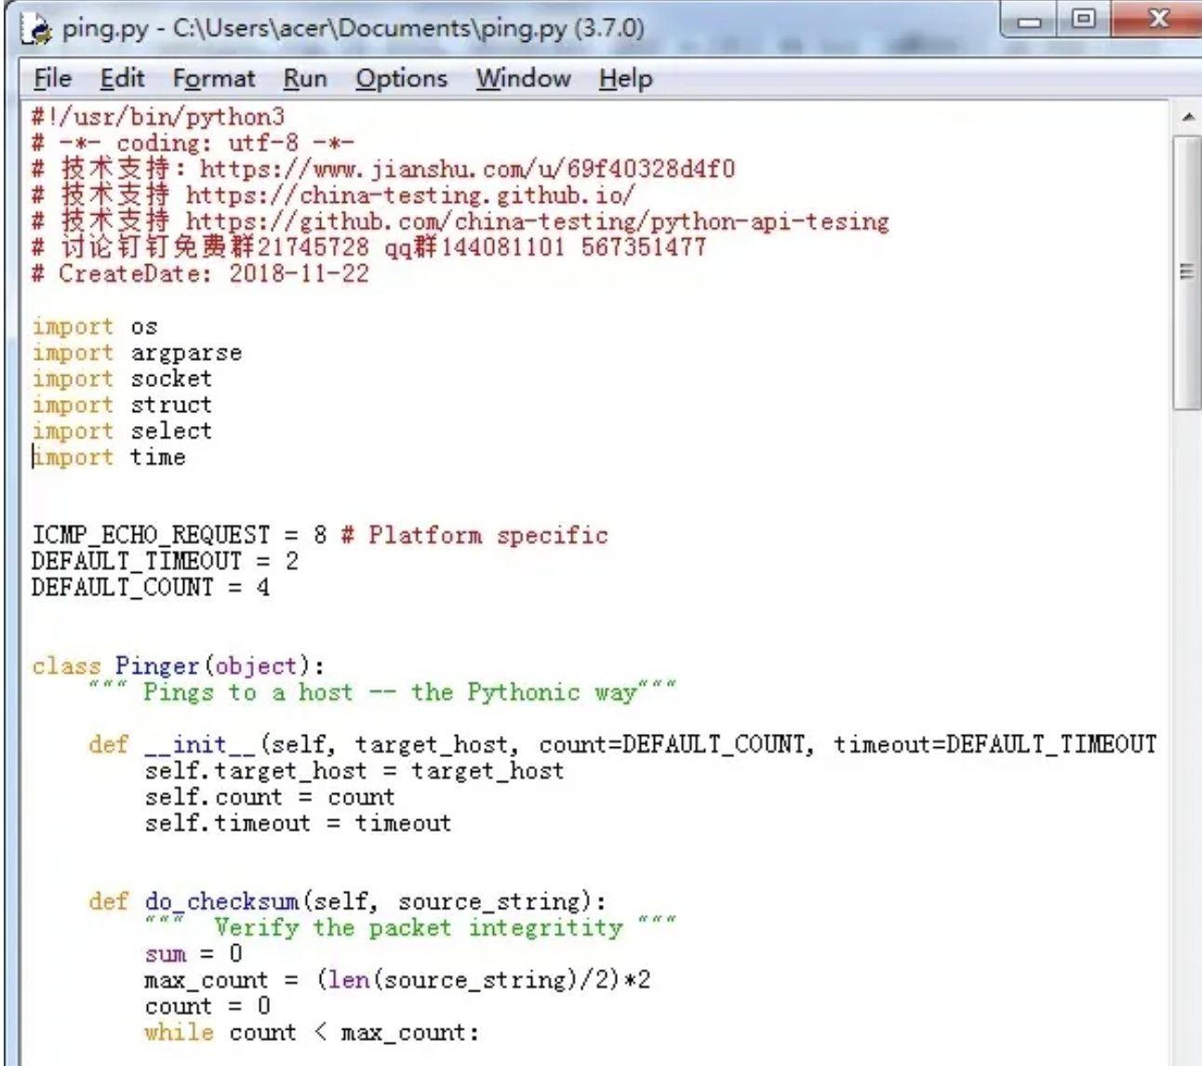
主流的IDE--IDLE
windows python和anaconda等自带安装，开箱即用，功能一般

Slide 9
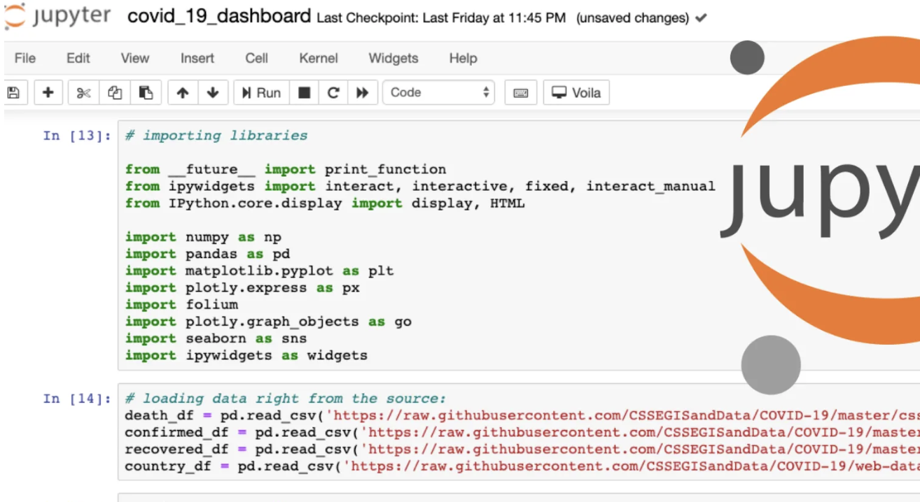
主流的IDE--Jupyter Notebook
Spyder是Python(x,y)的作者为它开发的一个简单的集成开发环境。和其他的Python开发环境相比，它最大的优点就是模仿MATLAB的"工作空间"的功能，可以很方便地观察和修改数组的值。最出名的python数据科学发行版本Anaconda自带了Spyder。

Slide 10
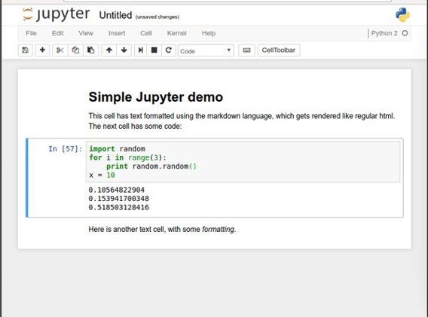
Noteable (Jupyter notebooks)
Easy to use environment
Web-based
Combines both text and code into one
Come with a great number of useful packages
Notes:
We will be using Noteable, just another service Jupyter Notebooks. It is free and open source
Web environment focused at Python
Easy to use – nice gui and no setup required
Block based. Has blocks which execute the code within it. Single type only
Allows to combine text and code into same page. Helps with readability

Slide 11
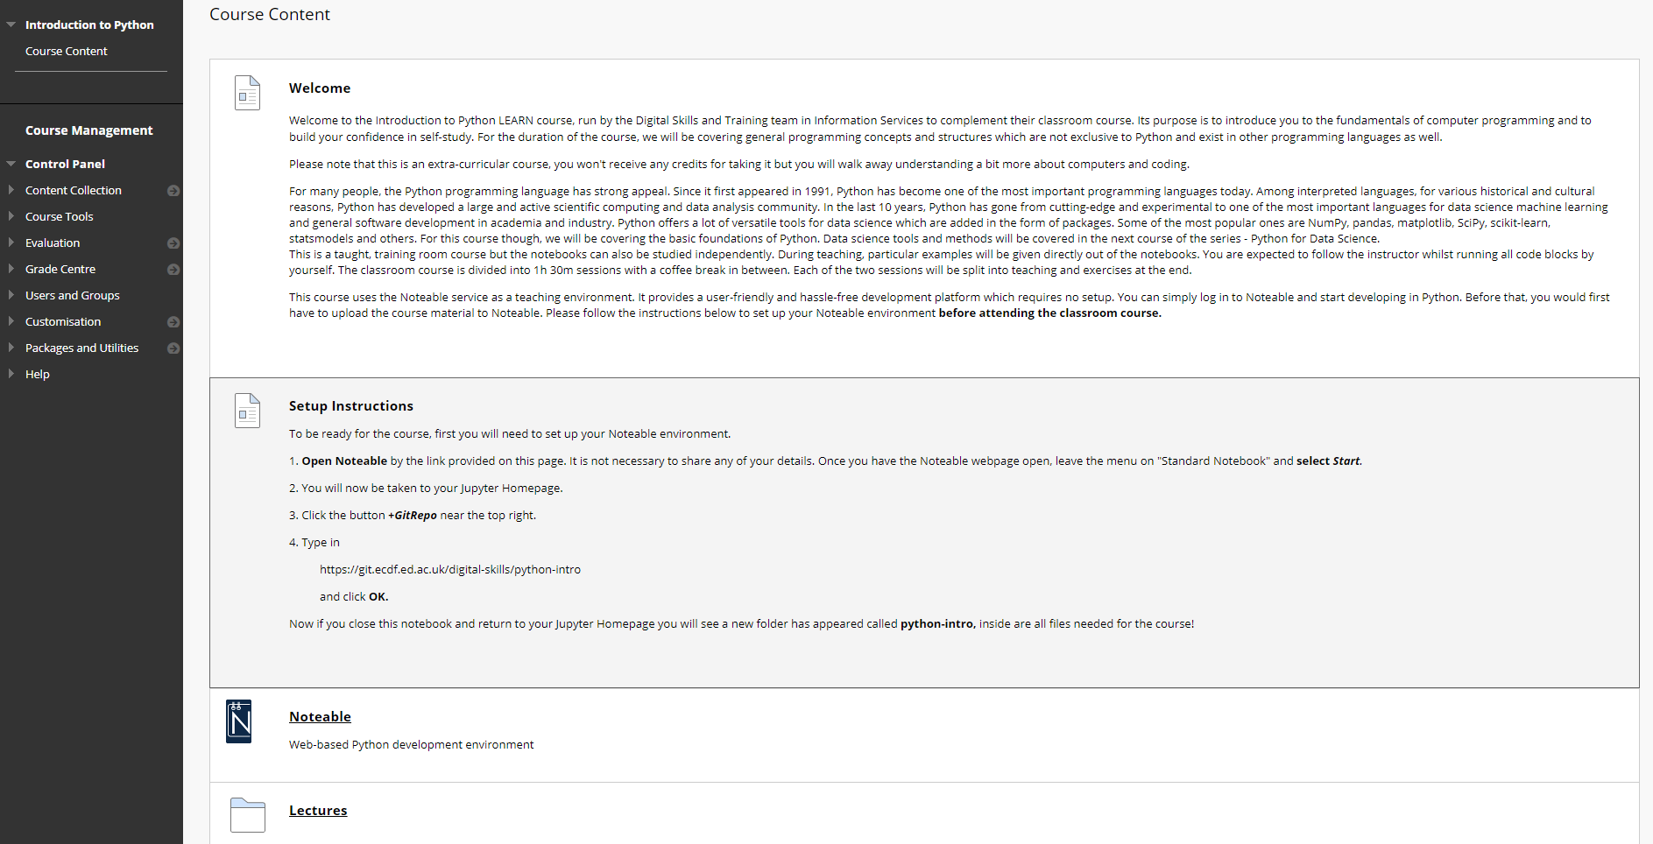
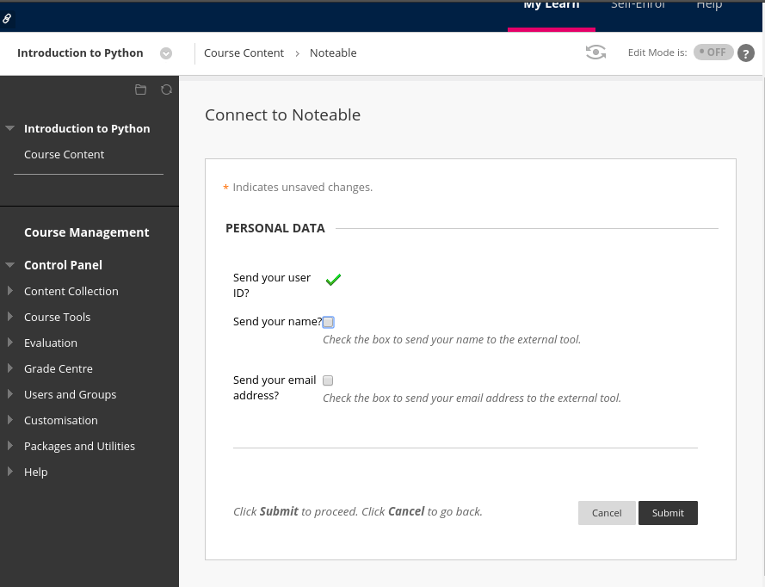
1. Start Noteable
Notes:
start noteable from learn - Link at the top of homepage
Agree on personal data usage
You don't have to share anything

Slide 12
Notes:
Probably enter myed login details
Then press start on noteable homepage

Slide 13
2. Clone GitRepo(recommended)

Slide 14
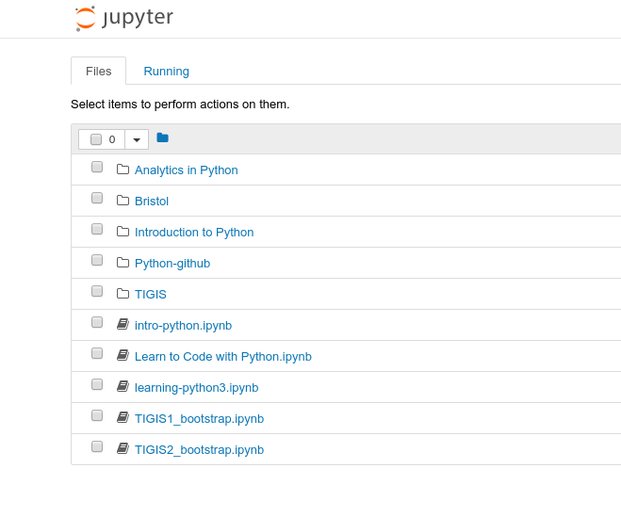
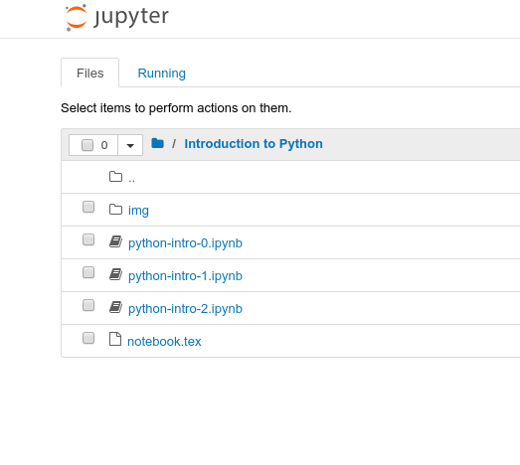
3. Starting a notebook
Notes:
Start a notebook by clicking on it.
Notebook 0 is an environment introduction.
Skip that, open notebook 1
Make sure that everybody is ready

Slide 15
4. Toolbar
Stop execution
Save
Cut, copy
paste
Block type
New block
Move block
Reset block
And clear output
Notes:
Autosave

Slide 16
5. Download files

Slide 17
6. Kernel/Restart & Clear output

Slide 18
7. Edit/Delete Cell

Slide 19
8. File/ Close & Halt

Slide 20
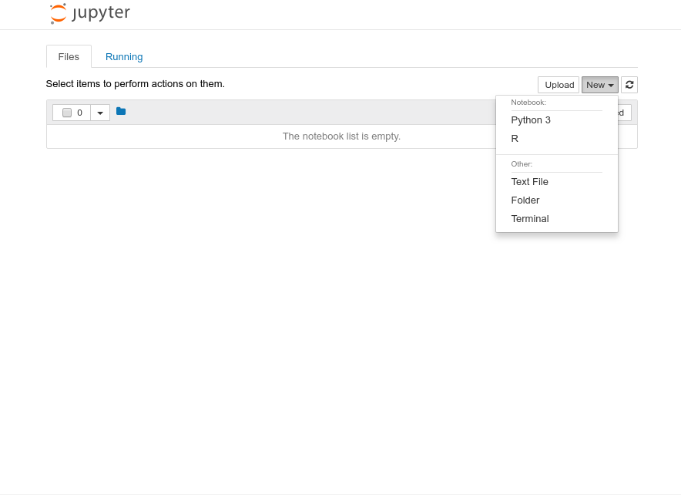
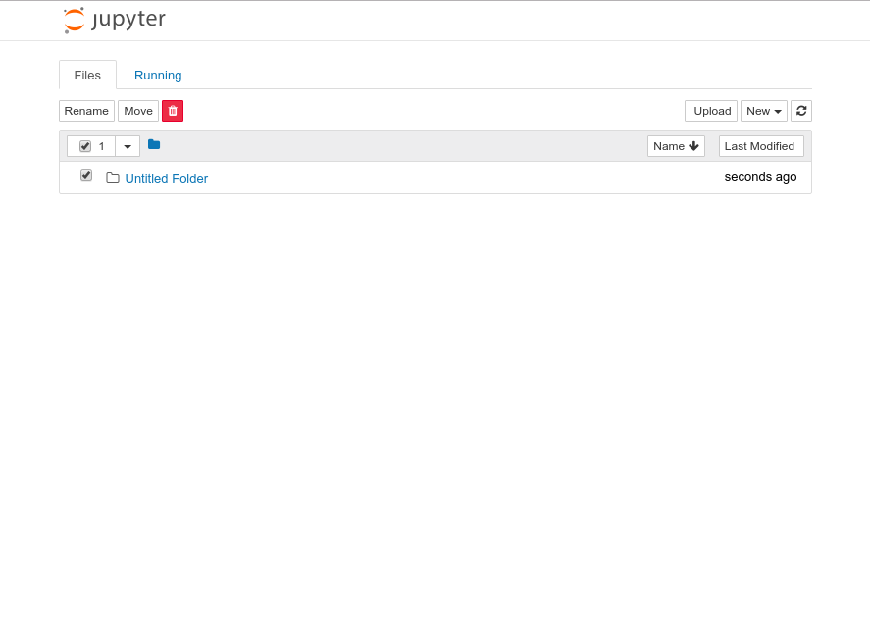
9. Create a folder 10.Rename
Notes:
We need to make a course folder
Then rename it to Introduction to Python or whatever
Then go into that folder

Slide 21
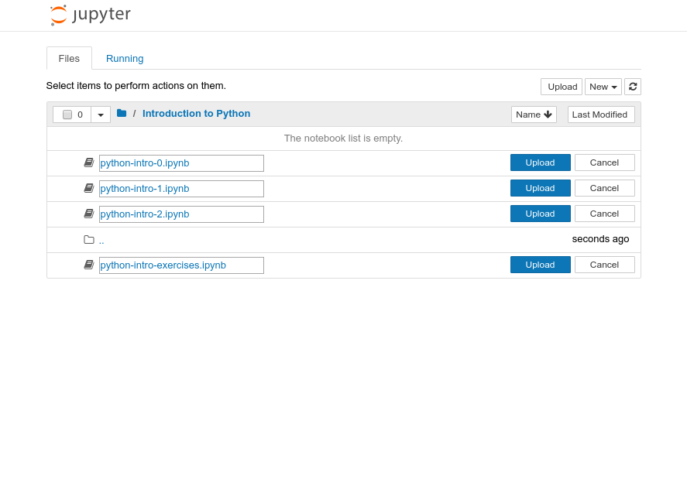
11. Upload files
Notes:
Make sure that you are inside that folder

Slide 22
Running blocks
By pressing the Run button
Shift + Enter – runs block
Alt + Enter – creates a new block
Notes:
Run button but its best with shortcut Shift + Return/Enter
Alt + Return/Enter which creates a new block after the on you are currently on.

Slide 23
Other operations
File/Save and Checkpoint
File/Revert to Checkpoint
Tab completion
Introspection
Notes:
Checkpoints are useful!
You can download it as multiple different things:
Notebook
Python script
pdf

Slide 24
Let us start
If you like to follow along, you can open your own notebook. But please try to keep up with my presentation, as you still have time for exercises after the teaching.

Slide 25
Agenda
Variables
Types
Arithmetic operators
Boolean logic
Strings
Printing
Exercises

Slide 26
Python as a calculator
Let us calculate the distance between Edinburgh and London in km
Notes:
Let's run our first block.
That's great
Writing numbers is very tedious
Run this in your notebooks
How can we improve that?

Slide 27
Variables
Great calculator but how can we make it store values?
Do this by defining variables
Can later be called by the variable name
Variable names are case sensitive and unique
Notes:
Can we save values? By defining a variable.
Can have values assigned
Variables must be declared and can then be called by name.
Code example
Check the code yourself

Slide 28
We can now reuse the variable mileToKm in the next block without having to define it again!
Notes:
reuse without having to type in again
Note: mileToKm not defined again

Slide 29
Types
Variables actually have a type, which defines the way it is stored.
The basic types are:
Notes:
So far - storing values in memory; how exactly are they stored?
defined by the type.
Go over all types

Slide 30
Why should we care?
Image by Clker-Free-Vector-Images on Pixabay
Notes:
Python decides the types, why should we care?
Python uses duck typing
Try running the next block

Slide 31
Important lesson to remember!
We can't do arithmetic operations on variables of different types. Therefore make sure that you are always aware of your variables types!
You can find the type of a variable using type(). For example type type(x).
Notes:
Explain code, run it.
we broke python. Any ideas?
Don't be afraid of errors, they are invaluable
we can't add up variables of different types.
important to remember! always take note of what the types of your variables are!
Python is helpful and gives us a hint.
Can you fix this particular block?

Slide 32
Casting types
Luckily Python offers us a way of converting variables to different types!
Casting – the operation of converting a variable to a different type
Similar methods exist for other data types: int(), float(), str()
Notes:
Casting – the operation of converting a variable to a different type
Let's try it on the previous code snippet.
Take note that this works only in a sensible way!

Slide 33
Quick quiz
What will be the result?

Slide 34
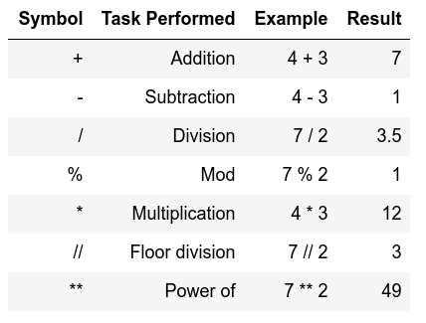
Arithmetic operations
Similar to actual Mathematics.
Order of precedence is the same as in Mathematics.
We can also use parenthesis ()
Notes:
Note of order precedence.
Table doesn't show this
Should be intuitive for all of you.

Slide 35
Order precedence example

Slide 36
Quick quiz
vs
13
49

Slide 37
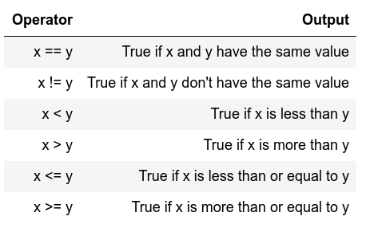
Comparison operators
I.e. comparison operators
Return Boolean values
(i.e. True or False)
Used extensively for conditional statements
Notes:
Similar to mathematics again
Will become important later on.

Slide 38
Comparison examples
False
Notes:
Note variable passing down
What will the 2nd block return?

Slide 39
Logical operators
Allows us to extend the conditional logic
Will become essential later on
Notes:
how we can combine comparison operators and logical operators

Slide 40
Combining both
True
True

Slide 41
Another example
True
True
True
That wasn't very easy to read was it?
Is there a way we can make it more readable?
Notes:
Another more complex example.
Here we check if x is divisible by 2 and if y is divisible by 3.
Can anybody guess why we are getting False?

Slide 42
Notes:
Simpler – store intermediate values
Easier to read
Generally advised

Slide 43
Strings
Powerful and flexible in Python
Can be added
Can be multiplied
Can be multiple lines

Slide 44
Strings

Slide 45
Strings
These are called methods and add extra functionality to the String.
If you want to see more methods that can be applied to a string simply type in dir('str')
Notes:
Functionality of strings can be extended through methods
should be in your notebooks but the dir() can be used on any Object/variable

Slide 46
Mixing up strings and numbers
Often we would need to mix up numbers and strings.
It is best to keep numbers as numbers (i.e. int or float)
and cast them to strings whenever we need them as a string.
Notes:
We need to mix numbers and strings often, ie. Whenever printing.
best to keep numbers as numbers
cast them to strings whenever needed.

Slide 47
Multiline strings
Notes:
Sometimes we need strings on multiple lines. How? Two ways?
One is using triple quotes """
The other one is using the new line character - \n

Slide 48
Printing
When writing scripts, your outcomes aren't printed on the terminal.
Thus, you must print them yourself with the print() function.
Beware to not mix up the different type of variables!

Slide 49
Quick quiz
Do you see anything wrong with this block?
Notes:
Let's see if everybody remembers their types
Is there anything wrong with this block or will it execute nicely?
[issue] Any idea how we can fix it?

Slide 50
Another more generic way to fix it
If we comma separate statements in a print function we can have different variables printing!

Slide 51
Placeholders
A way to interleave numbers is
Elegant and easy
more in your notes
Notes:
More examples including Exp, Octal, Hex, Etc in your notebooks

Slide 52
Commenting
Useful when your code needs further explanation. Either for your future self and anybody else.
Useful when you want to remove the code from execution but not permanently
Comments in Python are done with #
Notes:
You seen the # symbols in the slides.
I forget what I write; need to remind my future self
Programmers though it's better to write explanation in between the code
Show example

Slide 53
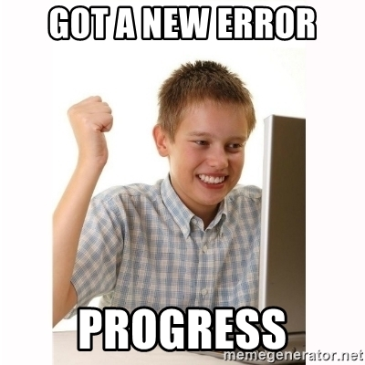
Exercise time 1
1.题目 有四个数字：1、2、3、4，能组成多少个互不相同且无重复数字的三位数？各是多少？
Notes:
error checking code , don't change it

Slide 54
Exercise time 1
1.题目 有四个数字：1、2、3、4，能组成多少个互不相同且无重复数字的三位数？各是多少？
total=0
for i in range(1,5):
for j in range(1,5):
for k in range(1,5):
if ((i!=j)and(j!=k)and(k!=i)):
print(i,j,k)
total+=1
print(total)
Notes:
error checking code , don't change it

Slide 55
Exercise time 2
完全平方数
题目 一个整数，它加上100后是一个完全平方数，再加上168又是一个完全平方数，请问该数是多少？

Slide 56
Exercise time 2
完全平方数
题目 一个整数，它加上100后是一个完全平方数，再加上168又是一个完全平方数，请问该数是多少？
n=0
while (n+1)**2-n*n<=168:
n+=1
print(n+1)

Slide 57
作业：
题目 企业发放的奖金根据利润提成。利润(I)低于或等于10万元时，奖金可提10%；利润高于10万元，低于20万元时，低于10万元的部分按10%提成，高于10万元的部分，可提成7.5%；20万到40万之间时，高于20万元的部分，可提成5%；40万到60万之间时高于40万元的部分，可提成3%；60万到100万之间时，高于60万元的部分，可提成1.5%，高于100万元时，超过100万元的部分按1%提成，从键盘输入当月利润I，求应发放奖金总数？

